Slide 1

Project Presentation
on
Smart Water Level Detection and Monitoring System Using Ultrasonic Sensor
Sourav Reg. no. – 2024PUFCEBCEX1
Shubham Swami Reg. no – 2024PUFCEBCEX17980
Swaroop Singh Reg. no. – 2024PUFCEBCEX16912
Tanmay Khandelwal Reg. no. – 2024PUFCEBCEX17980
Department of First Year
Poornima University, Jaipur
Under the Supervision of
Abhishek Kumar Singh
Assistant Professor,
Faculty of Computer Science and Engineering,
Poornima University, Jaipur
Submitted To:
Department of First Year
Poornima University, Jaipur

Slide 2

Introduction
Project Title: Smart Water Level Detection Using Ultrasonic Sensor
Objective:
To create a system that accurately detects and monitors water levels in containers using an ultrasonic sensor, with alerts for high or low water levels.
Components:
Arduino
Ultrasonic Sensor
Buzzer
LCD/Serial Monitor
Goal:
Efficient water management by providing real-time water level data and alerts.

Slide 3

What This Project is About
This project focuses on building a Smart Water Level Detection System using an Ultrasonic Sensor and Arduino. The system measures the distance between the sensor and the water surface, which is then used to calculate the water level in the container.
Key Features:
Distance Measurement: The ultrasonic sensor measures the distance to the water surface.
Water Level Calculation: The system calculates the water level based on the distance readings.
Alerts: The system provides alerts when the water level is too high or too low using a buzzer and displays data on a monitor.
Application:
This project can be applied in:
Water Tanks
Reservoirs
Rainwater Harvesting Systems

Slide 4
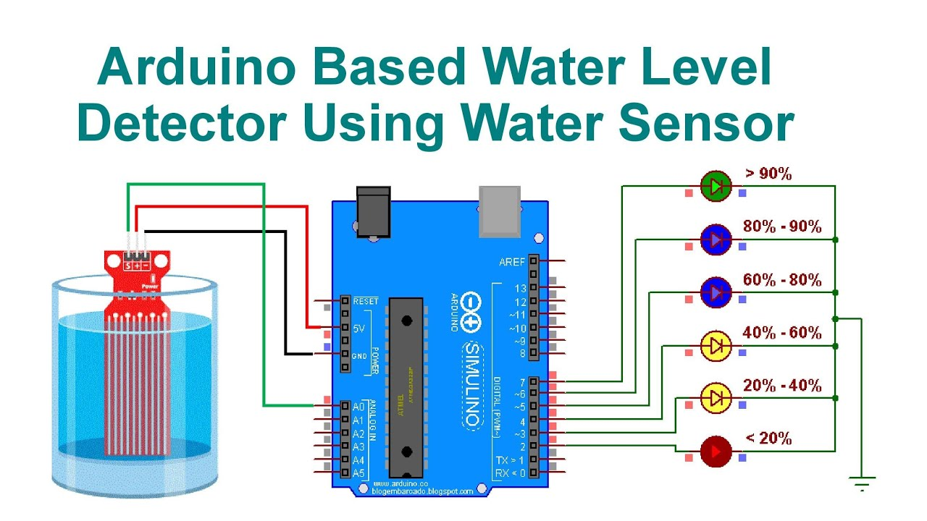
AIM OF THE PROJECT
The aim of this project is to design and implement a Smart Water Level Detection System that:
Accurately measures water levels in a container using an Ultrasonic Sensor and Arduino.
Provides real-time monitoring of water levels and displays it on a serial monitor or LCD screen.
Sends alerts (visual or audible) when the water level is too high or too low, helping in efficient water management.
Improves resource management and prevents overflows or shortages in water storage systems.

Slide 5
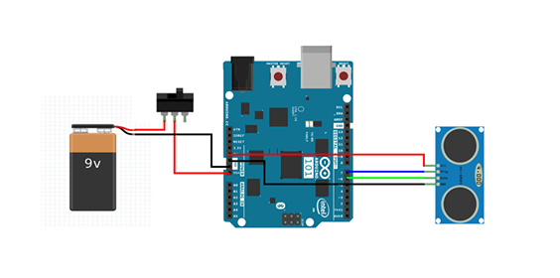
Technical Details of the Project
Components:
Arduino Uno: Central controller.
Ultrasonic Sensor (HC-SR04): Measures waste level.
Buzzer: Alerts when bin is full.
Laptop: Displays real-time data.
Working:
The ultrasonic sensor measures distance, and Arduino processes the data to trigger the buzzer when the bin is nearly full. The result is displayed on the laptop.

Slide 6
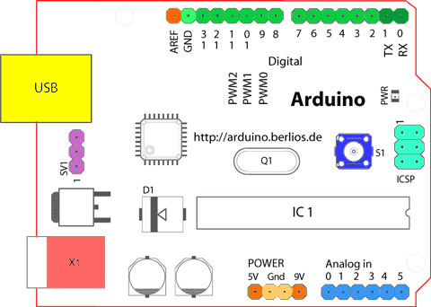
Working of the Project
Components Used:
Arduino Uno
Ultrasonic Sensor (HC-SR04)
Buzzer
LCD/Serial Monitor
Working Principle:
The ultrasonic sensor measures the distance to the water surface.
The Arduino calculates the water level and triggers the buzzer if the level is too high or low.
Data is displayed on the Serial Monitor or LCD screen.

Slide 7
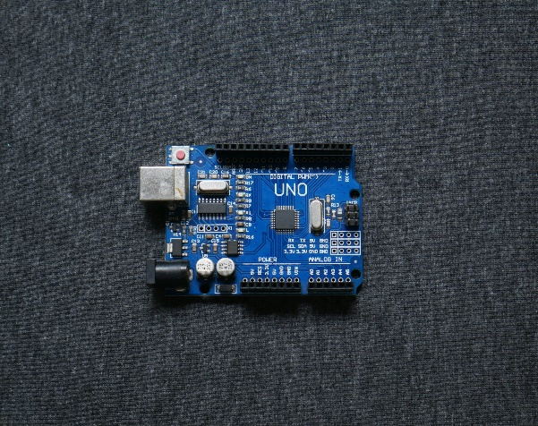
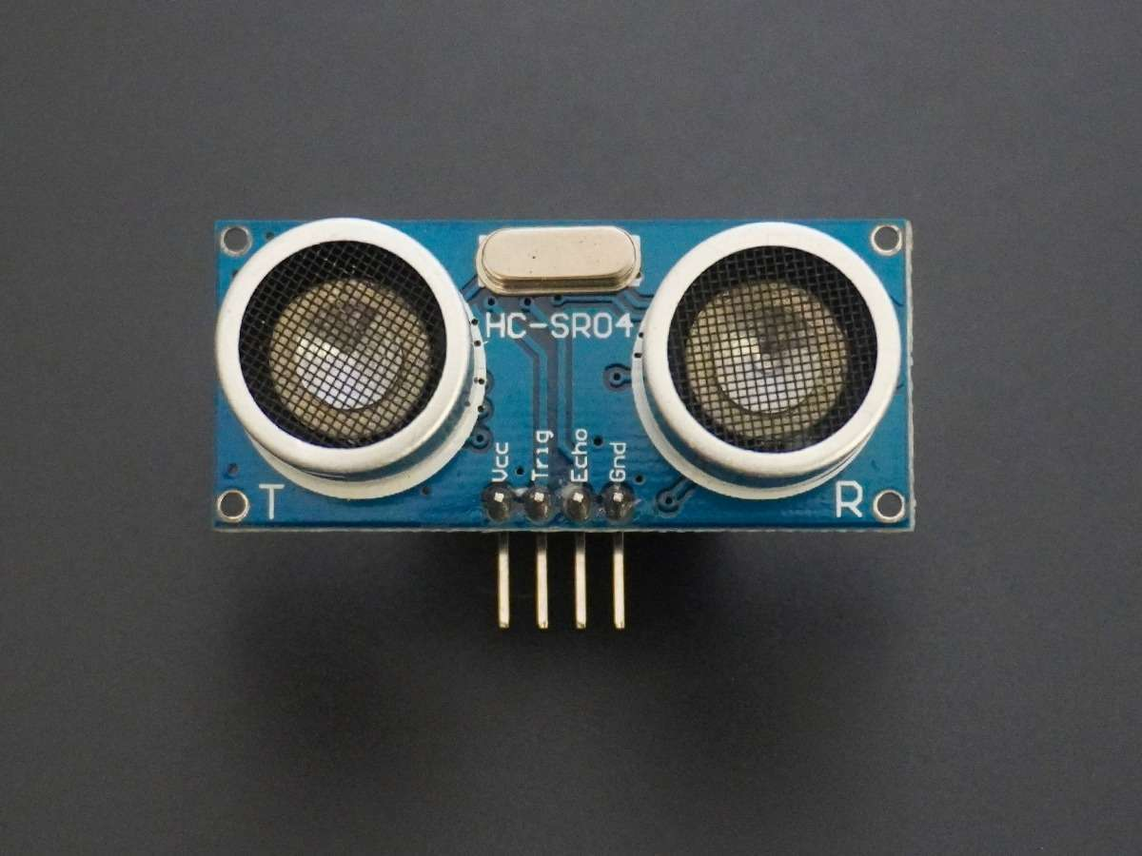
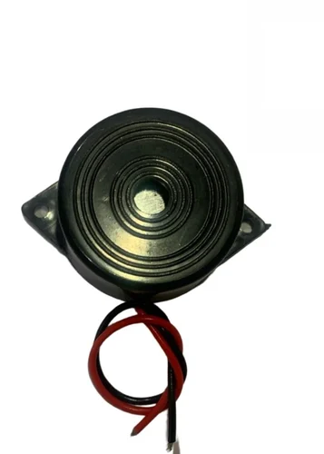
Pictures of main components used
Arduino board
Ultrasonic sensors
Buzzer

Slide 8
Conclusion and Future Work
Conclusion:
The Smart Water Level Detection System successfully monitors and displays the water level in real-time.
Ultrasonic sensors provide accurate distance measurements to calculate water levels.
Buzzer alerts notify users when the water level is too high or too low, enhancing water management and preventing overflow or shortages.
Future Work:
Wireless Communication: Implementing wireless features (e.g., IoT) to send water level data to remote devices or cloud platforms.
Automation: Integrating an automatic water refill or drainage system based on the detected water levels.
Multiple Sensor Setup: Using multiple sensors for larger tanks or reservoirs for more accurate measurements.

Slide 9
References
Arduino Documentation Official Arduino website: https://www.arduino.cc/
Ultrasonic Sensor HC-SR04 Datasheet and usage guide: https://www.electronicwings.com
Arduino IDE and Libraries
Arduino IDE setup and libraries: https://www.arduino.cc/en/Main/Software
Water Level Detection Using Ultrasonic Sensor https://www.instructables.com – Various tutorials on water level monitoring with Arduino.
Sensor Tutorials
SparkFun Electronics: https://www.sparkfun.com

Slide 10


